Slide 1
GreenOps for
Tech Leaders
A Practical Guide to Sustainable IT
Notes:
Hello and welcome
Housekeeping
Toilets
Fire
Food and drink

Slide 2

Notes:
Take away that you can do this too
Why do it
Technical details on how to measure
Designing for sustainability
What we’ve done at UKHSA
How you can apply in your organisations
Conversational + informal. Ask questions as we go. Also time for Q&A at the end

Slide 3

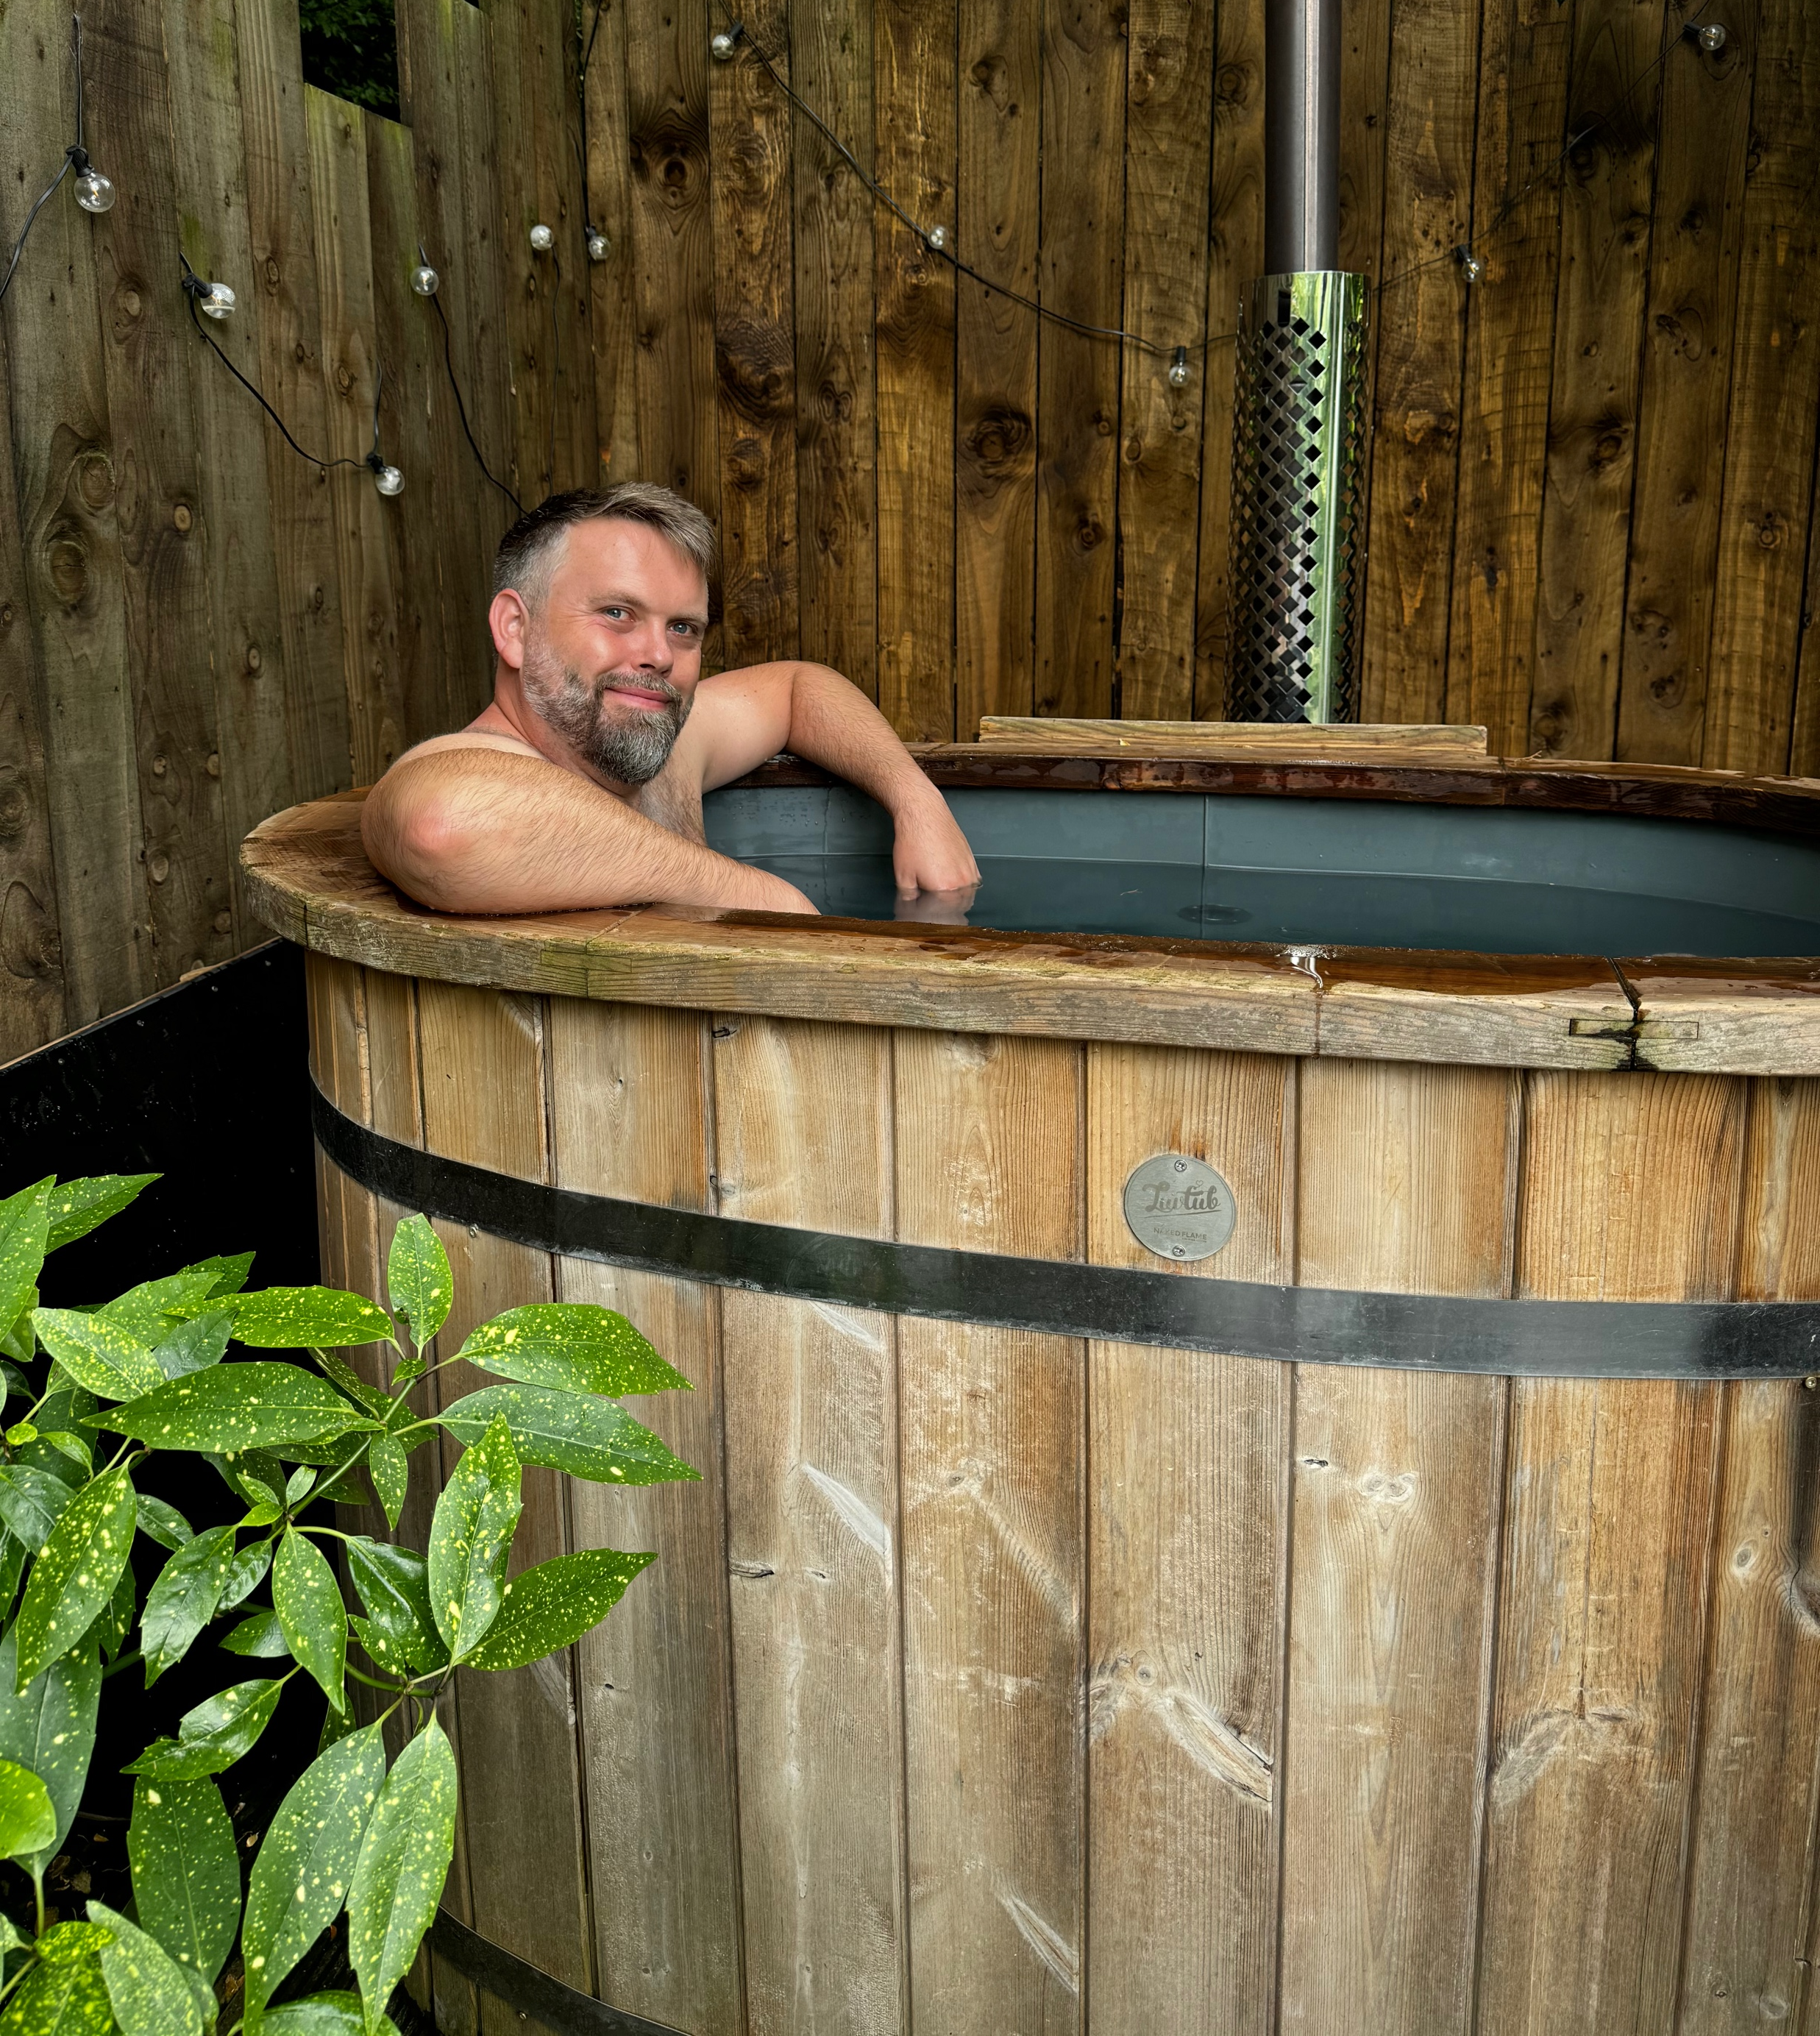
Hello
Notes:
Kev
Cloud architect at Burendo
AWS partners
20+ years designing and building enterprise and consumer apps
Last 5 years in NHS and Govt
Primarily in AWS
Graham
??

Slide 4

Notes:
Audience learning objective (Graham)

Slide 5
#1
It will save you money
Notes:
Audience benefit (Graham)
Cloud based Green Ops calculations based on cost savings
Linked directly to cloud usage
Data centre impact on environment

Slide 6
#2
Reduce carbon impact
Notes:
Audience benefit (Graham)
Make your carbon impact more visible
Implement process to review
Celebrate reduction emissions

Slide 7
#3
Improved org awareness
Notes:
Audience benefit (Graham)
Encourage stakeholder buy in
Embed in governance
Understand the organisations policies

Slide 8
#4
Part of your dev ecosystem
Notes:
Audience benefit (Graham)
Embed in CI/CD
Alert as part of reviews
Use IaC and tooling

Slide 9
#5
Design for sustainability
Notes:
Audience benefit (Graham)
Upskill architects in serverless
Prefer PaaS over IaaS and where possible, SaaS
Make people care

Slide 10

Notes:
Sustainable IT, Green Ops, CO2e

Slide 11
Sustainable IT
Notes:
Key points to achieve learning objective (Kev)

Slide 12
sustainable adj.
involving the use of natural products and energy in a way that does not harm the environment
Notes:
Oxford English dictionary
Measure, predict, and reduce the carbon emissions associated with IT infrastructure and cloud workloads.
Whole supply chain – servers, people, offices, hardware etc
In 2023, AWS saved more than 22,000 tonnes of carbon dioxide equivalent emissions, through its use of lower-carbon concrete and steel alternatives in the construction of 43 new data centre facilities.

Slide 13
GreenOps
Notes:
Key points to achieve learning objective (Kev)

Slide 14
maximising the value of your cloud provisions for sustainability as well as typical considerations like performance, security, and cost
Notes:
Some history….
+ show of hands
DevOps => move way from traditional approaches. Collaboration. Automate. Build, ship, and operate digital services more effectively
FinOps => cloud became more popular. Bringing finance to the mix. Cost control and accountability
GreenOps => adding sustainability considerations. The cloud is material. Carbon emissions, water use, and demand on (hopefully) renewable energy that could be used elsewhere

Slide 15
Carbon Dioxide
Equivalent
(CO2e)
Notes:
Key points to achieve learning objective (Kev)

Slide 16
the number of metric tons of CO2 emissions with the same global warming potential as one metric ton of another greenhouse gas
Notes:
Main greenhouse gasses are water vapour, carbon dioxide (CO2), methane (CH4), nitrous oxide (N2O) and ozone
different greenhouse gases last in the atmosphere for different lengths of time, and they also absorb different amounts of heat
“global warming potential” (or “GWP”) of a GHG indicates the amount of warming a gas causes over a given period of time (normally 100 years). GWP is an index, with CO2 having the index value of 1, and the GWP for all other GHGs is the number of times more warming they cause compared to CO2. E.g. 1kg of methane causes 29.8 times more warming over a 100 year period compared to 1kg of CO2, and so methane has a GWP of 29.8
A quantity of GHG can be expressed as CO2e by multiplying the amount of the GHG by its GWP. E.g. if 1kg of methane is emitted, this can be expressed as 29.8kg of CO2e (1kg CH4 * 29.8 = 29.8kg CO2e).

Slide 17

Design for
sustainability
Notes:
Right-size underutilized instances: Adjust the size of cloud computing resources to match what’s actually needed, to avoid paying for capacity you aren’t using. (An ‘instance’ is essentially a virtual server rented from third-party cloud services, allowing you access to compute resources to run applications, databases, microservices, etc.).
Select energy-efficient instance types: Choose computing resources that use less energy for the same work, similar to preferring an energy-efficient refrigerator that uses less electricity.
Review aged instances: Check and update or replace cloud resources that have been running for over a year. Newer options might be more efficient or sustainable.
Terminate unused instances: Stop and remove cloud resources that are no longer in use. Like switching off the light when you leave a room!
Terminate zombie instances: Identify and remove cloud resources that are running, but not for any good reason.
Increase usage of auto-scaling and scheduling: Automate the adjustment of resources based on need, ensuring that you have more when demand is high and less when it’s low.
7. Prefer serverless architecture and manage services
8. Consider regionality

Slide 18
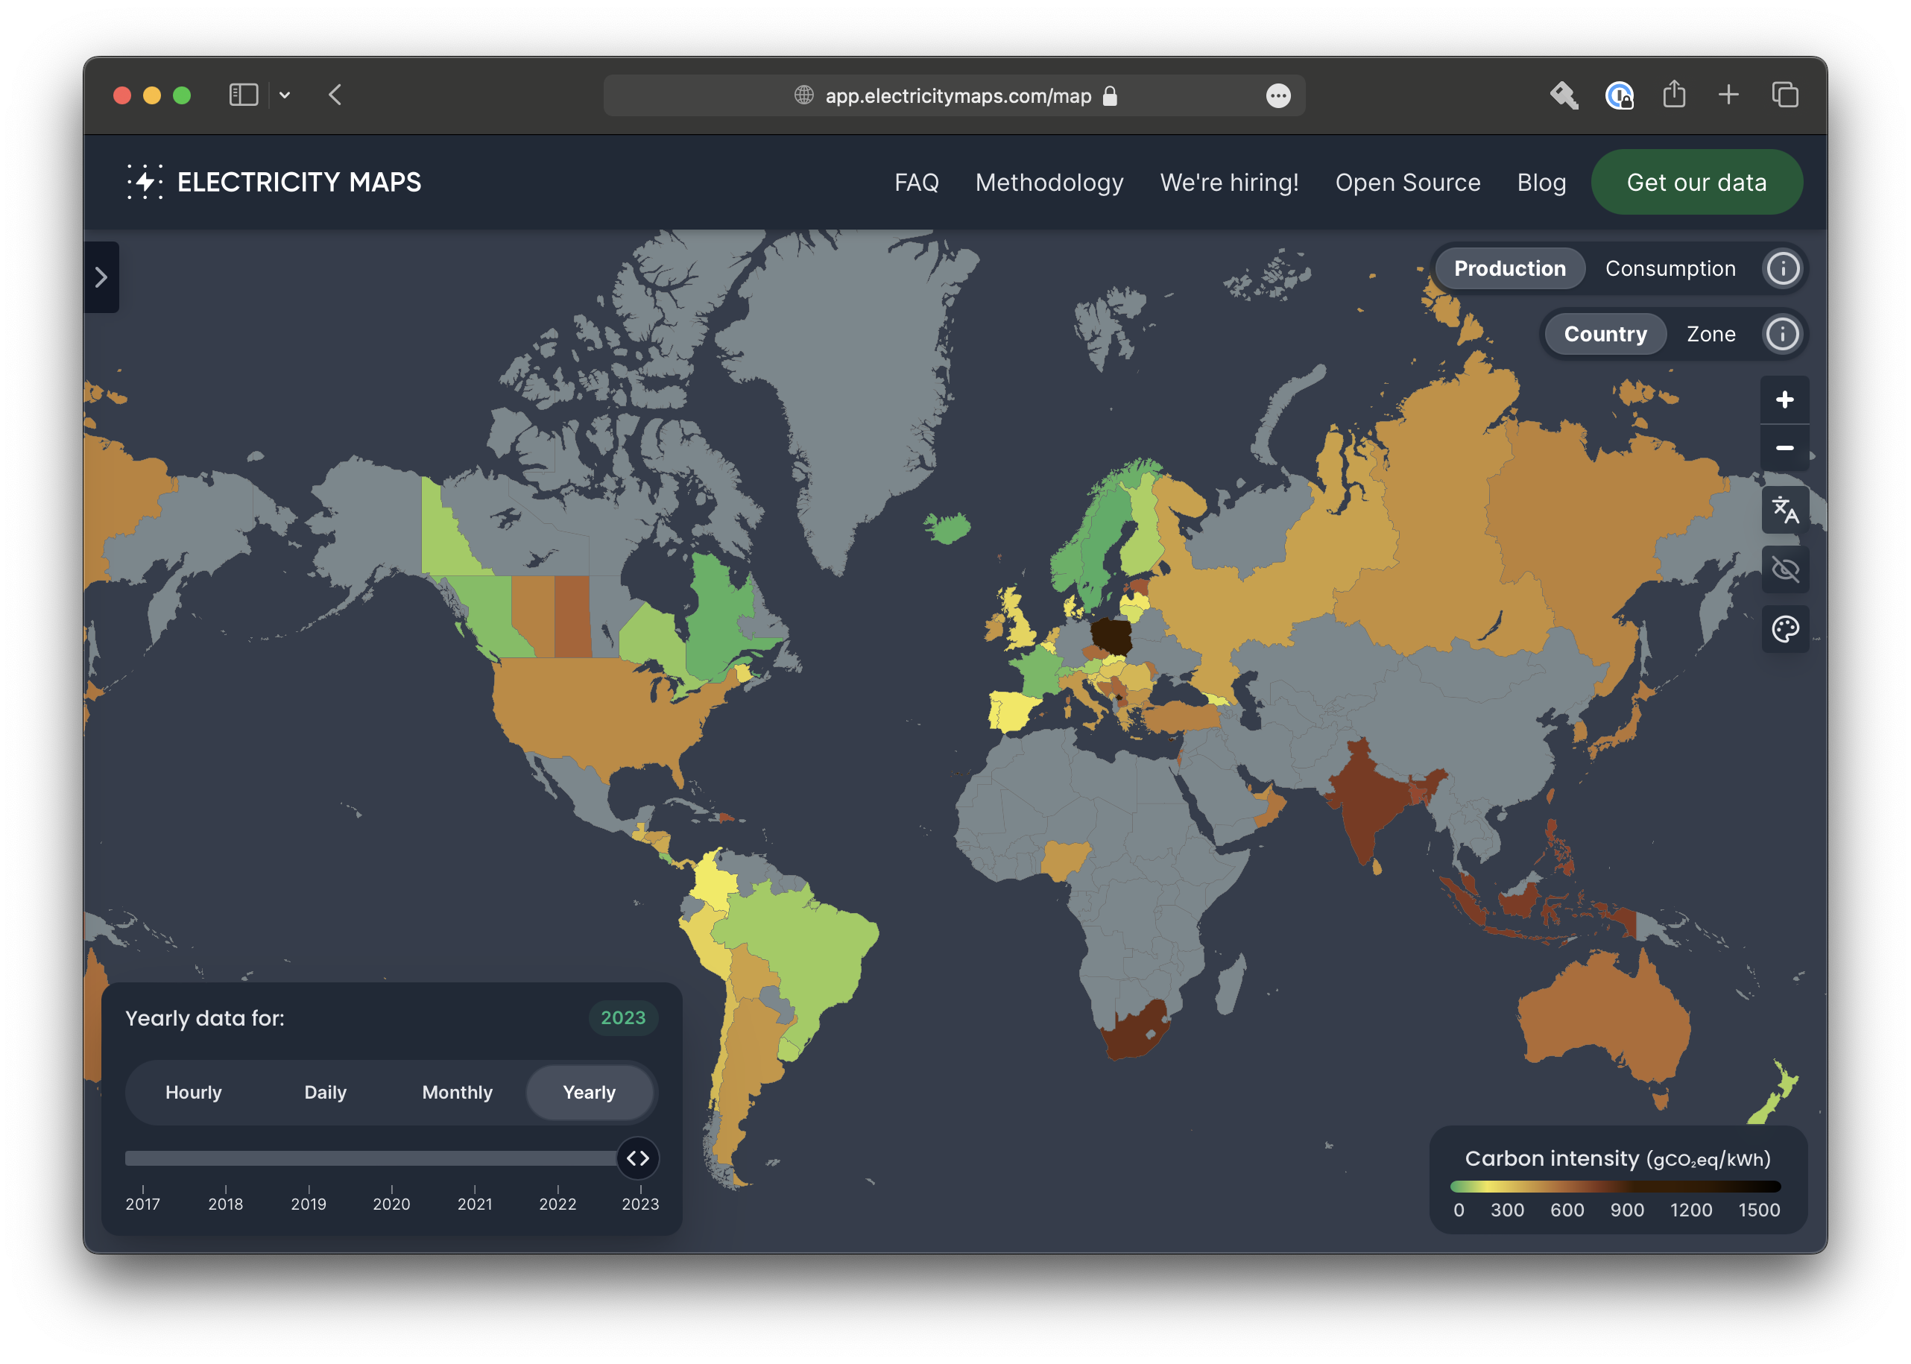
Notes:
Right-size underutilized instances: Adjust the size of cloud computing resources to match what’s actually needed, to avoid paying for capacity you aren’t using. (An ‘instance’ is essentially a virtual server rented from third-party cloud services, allowing you access to compute resources to run applications, databases, microservices, etc.).
Select energy-efficient instance types: Choose computing resources that use less energy for the same work, similar to preferring an energy-efficient refrigerator that uses less electricity.
Review aged instances: Check and update or replace cloud resources that have been running for over a year. Newer options might be more efficient or sustainable.
Terminate unused instances: Stop and remove cloud resources that are no longer in use. Like switching off the light when you leave a room!
Terminate zombie instances: Identify and remove cloud resources that are running, but not for any good reason.
Increase usage of auto-scaling and scheduling: Automate the adjustment of resources based on need, ensuring that you have more when demand is high and less when it’s low.
7. Prefer serverless architecture and manage services
8. Consider regionality

Slide 19
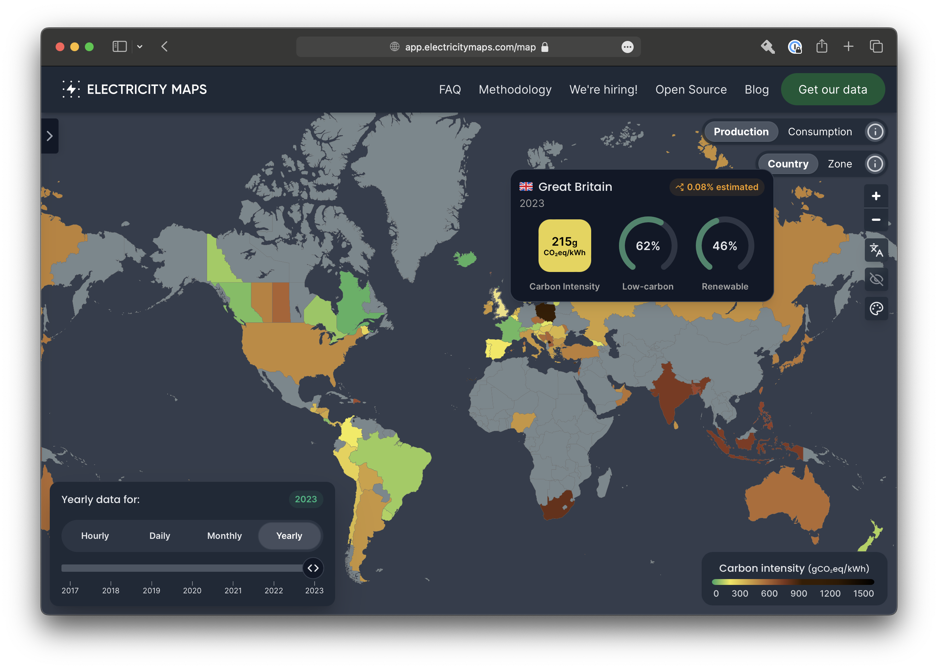
Notes:
Right-size underutilized instances: Adjust the size of cloud computing resources to match what’s actually needed, to avoid paying for capacity you aren’t using. (An ‘instance’ is essentially a virtual server rented from third-party cloud services, allowing you access to compute resources to run applications, databases, microservices, etc.).
Select energy-efficient instance types: Choose computing resources that use less energy for the same work, similar to preferring an energy-efficient refrigerator that uses less electricity.
Review aged instances: Check and update or replace cloud resources that have been running for over a year. Newer options might be more efficient or sustainable.
Terminate unused instances: Stop and remove cloud resources that are no longer in use. Like switching off the light when you leave a room!
Terminate zombie instances: Identify and remove cloud resources that are running, but not for any good reason.
Increase usage of auto-scaling and scheduling: Automate the adjustment of resources based on need, ensuring that you have more when demand is high and less when it’s low.
7. Prefer serverless architecture and manage services
8. Consider regionality

Slide 20
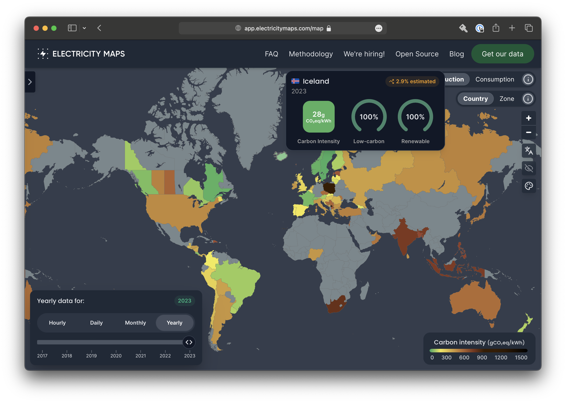
Notes:
Right-size underutilized instances: Adjust the size of cloud computing resources to match what’s actually needed, to avoid paying for capacity you aren’t using. (An ‘instance’ is essentially a virtual server rented from third-party cloud services, allowing you access to compute resources to run applications, databases, microservices, etc.).
Select energy-efficient instance types: Choose computing resources that use less energy for the same work, similar to preferring an energy-efficient refrigerator that uses less electricity.
Review aged instances: Check and update or replace cloud resources that have been running for over a year. Newer options might be more efficient or sustainable.
Terminate unused instances: Stop and remove cloud resources that are no longer in use. Like switching off the light when you leave a room!
Terminate zombie instances: Identify and remove cloud resources that are running, but not for any good reason.
Increase usage of auto-scaling and scheduling: Automate the adjustment of resources based on need, ensuring that you have more when demand is high and less when it’s low.
7. Prefer serverless architecture and manage services
8. Consider regionality

Slide 21
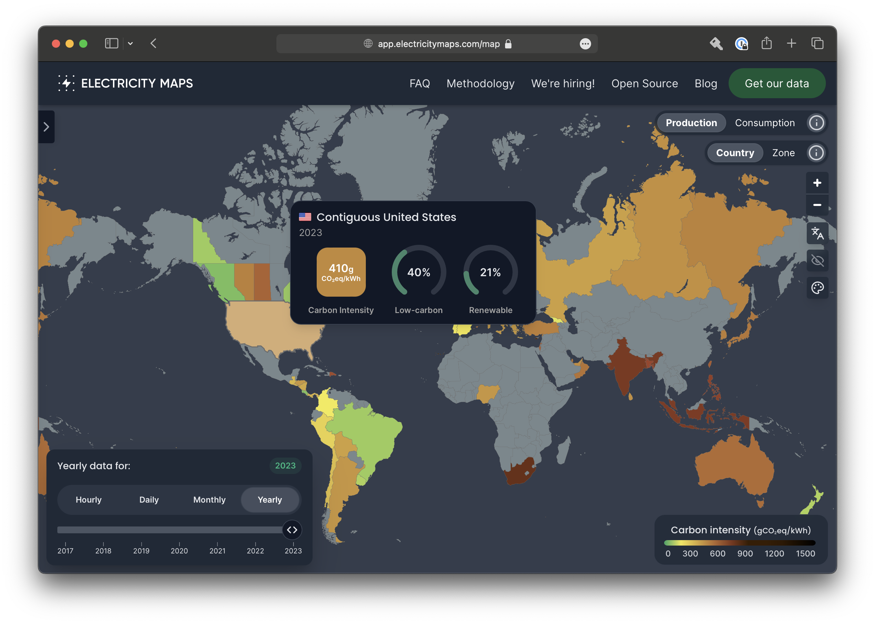
Notes:
Right-size underutilized instances: Adjust the size of cloud computing resources to match what’s actually needed, to avoid paying for capacity you aren’t using. (An ‘instance’ is essentially a virtual server rented from third-party cloud services, allowing you access to compute resources to run applications, databases, microservices, etc.).
Select energy-efficient instance types: Choose computing resources that use less energy for the same work, similar to preferring an energy-efficient refrigerator that uses less electricity.
Review aged instances: Check and update or replace cloud resources that have been running for over a year. Newer options might be more efficient or sustainable.
Terminate unused instances: Stop and remove cloud resources that are no longer in use. Like switching off the light when you leave a room!
Terminate zombie instances: Identify and remove cloud resources that are running, but not for any good reason.
Increase usage of auto-scaling and scheduling: Automate the adjustment of resources based on need, ensuring that you have more when demand is high and less when it’s low.
7. Prefer serverless architecture and manage services
8. Consider regionality

Slide 22
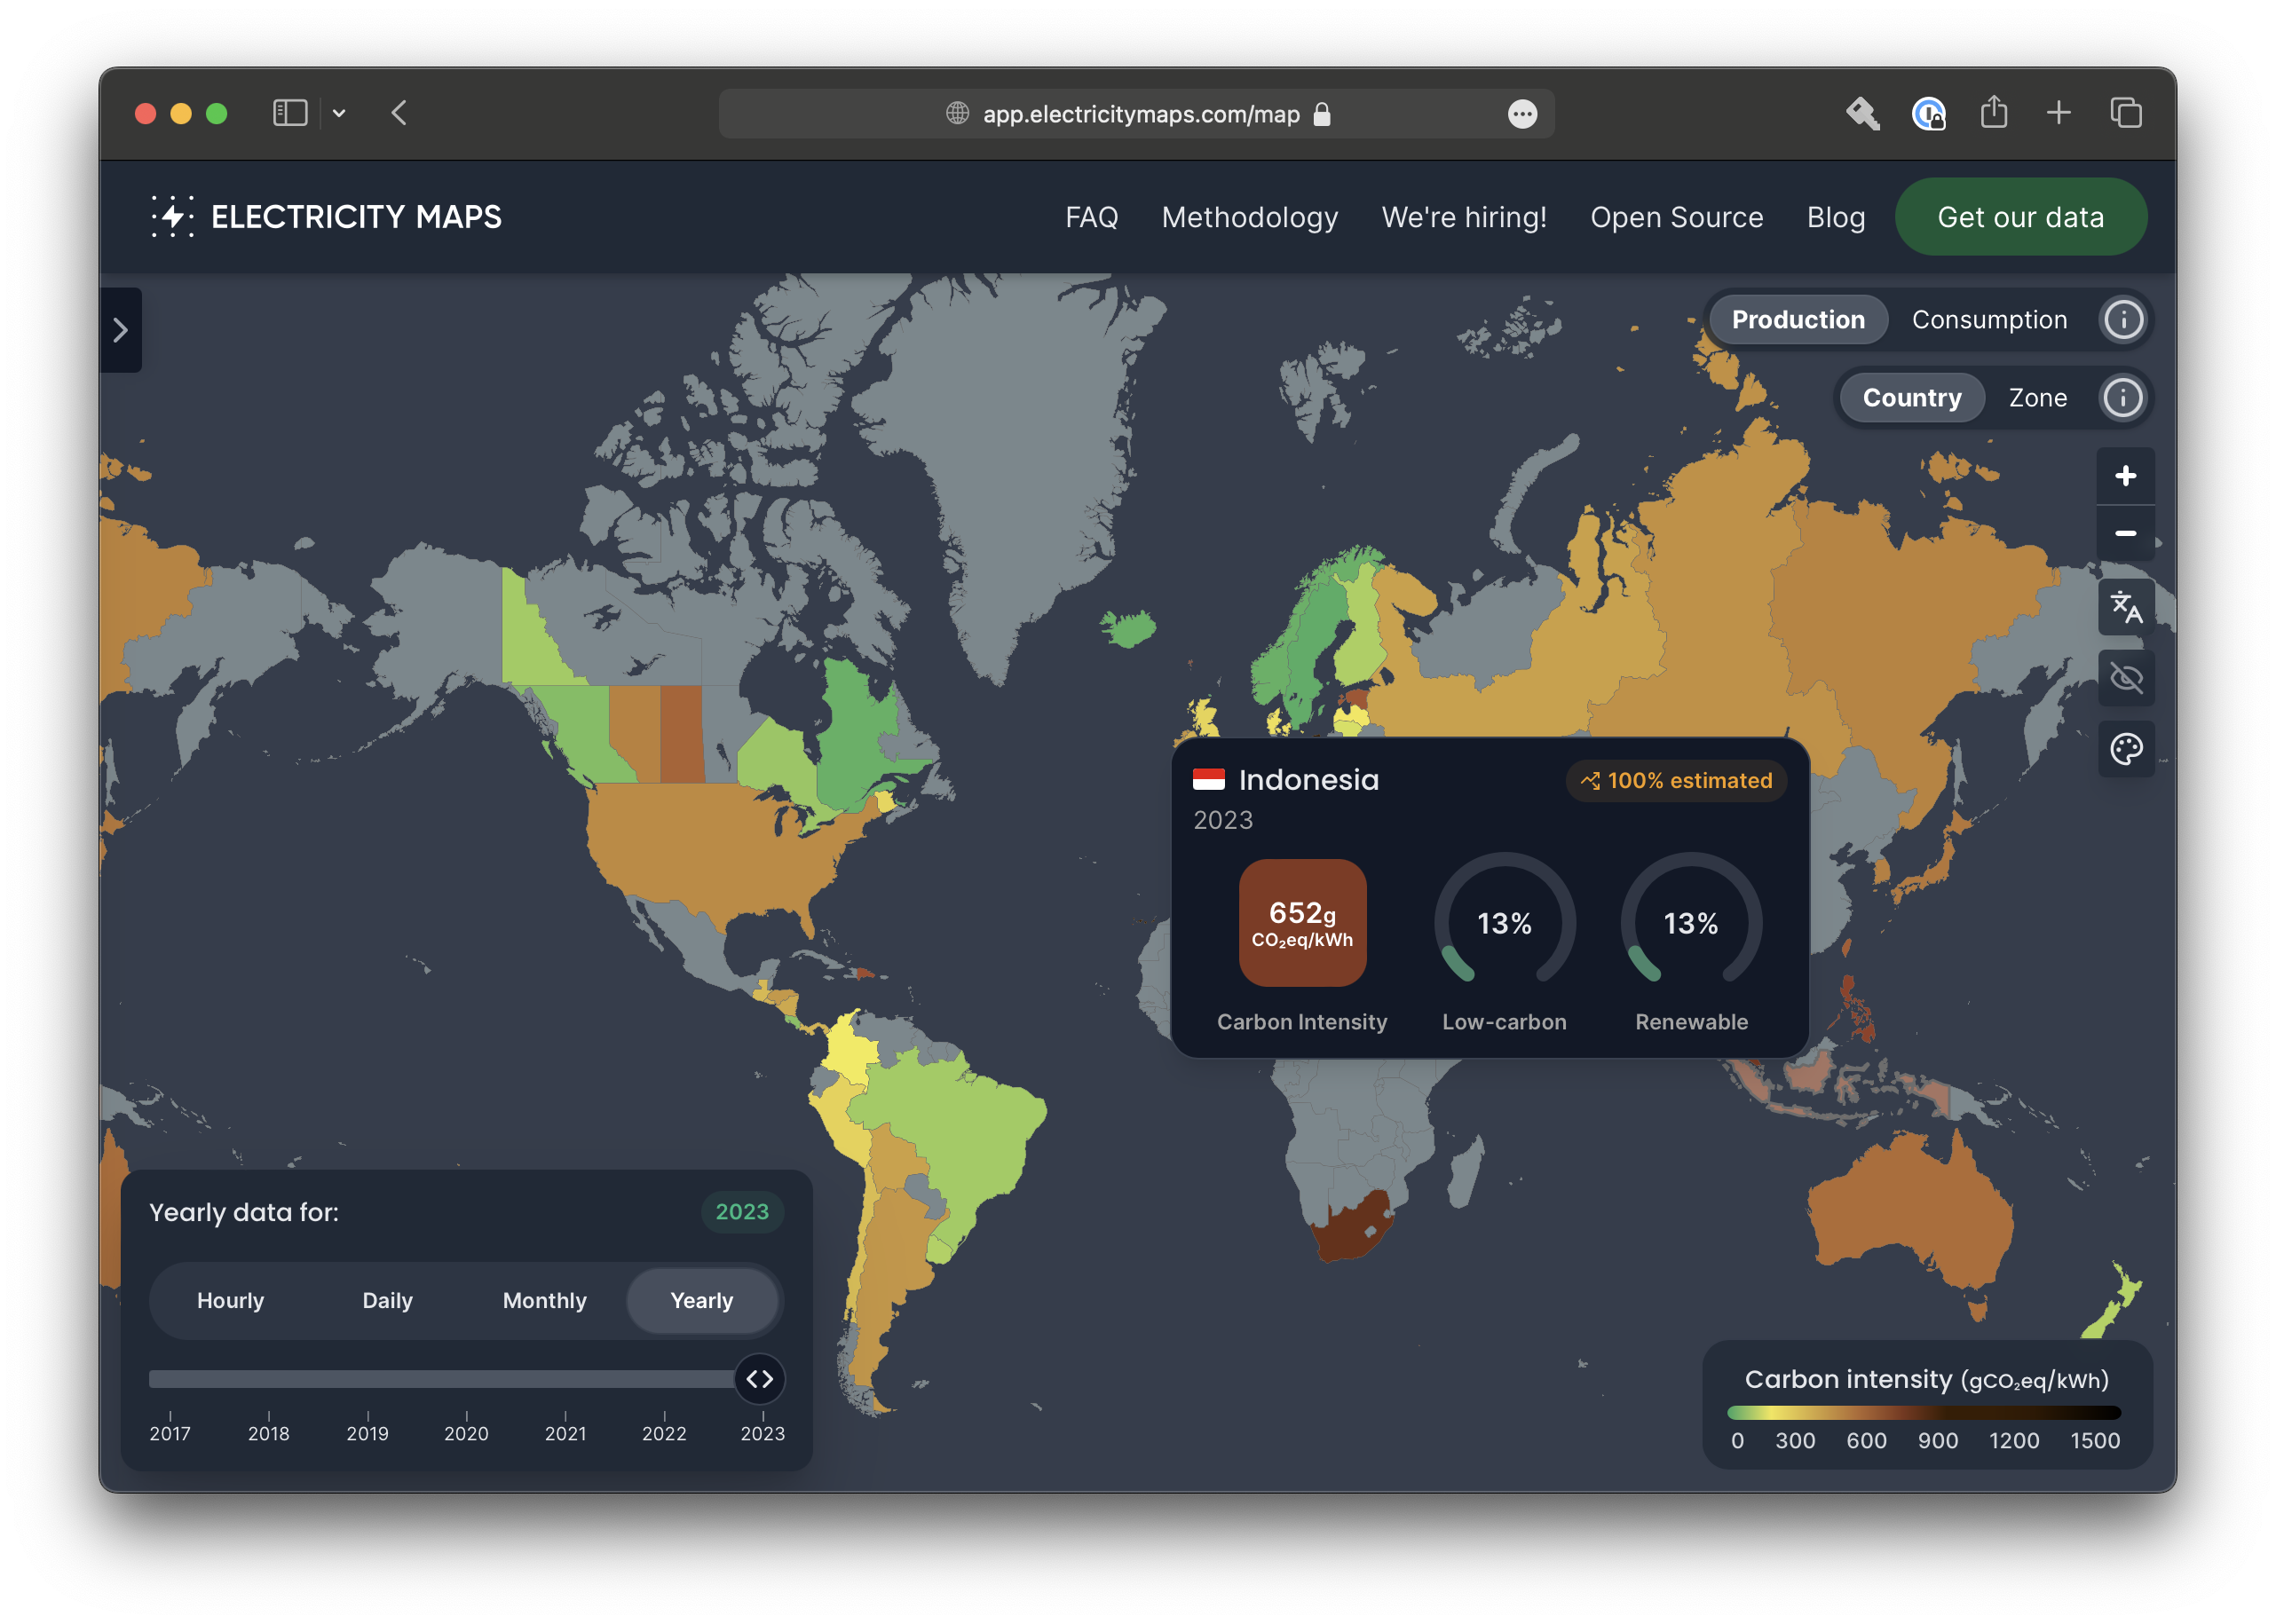
Notes:
Right-size underutilized instances: Adjust the size of cloud computing resources to match what’s actually needed, to avoid paying for capacity you aren’t using. (An ‘instance’ is essentially a virtual server rented from third-party cloud services, allowing you access to compute resources to run applications, databases, microservices, etc.).
Select energy-efficient instance types: Choose computing resources that use less energy for the same work, similar to preferring an energy-efficient refrigerator that uses less electricity.
Review aged instances: Check and update or replace cloud resources that have been running for over a year. Newer options might be more efficient or sustainable.
Terminate unused instances: Stop and remove cloud resources that are no longer in use. Like switching off the light when you leave a room!
Terminate zombie instances: Identify and remove cloud resources that are running, but not for any good reason.
Increase usage of auto-scaling and scheduling: Automate the adjustment of resources based on need, ensuring that you have more when demand is high and less when it’s low.
7. Prefer serverless architecture and manage services
8. Consider regionality

Slide 23
UKHSA
data dashboard
Notes:
My personal story (kev)

Slide 24
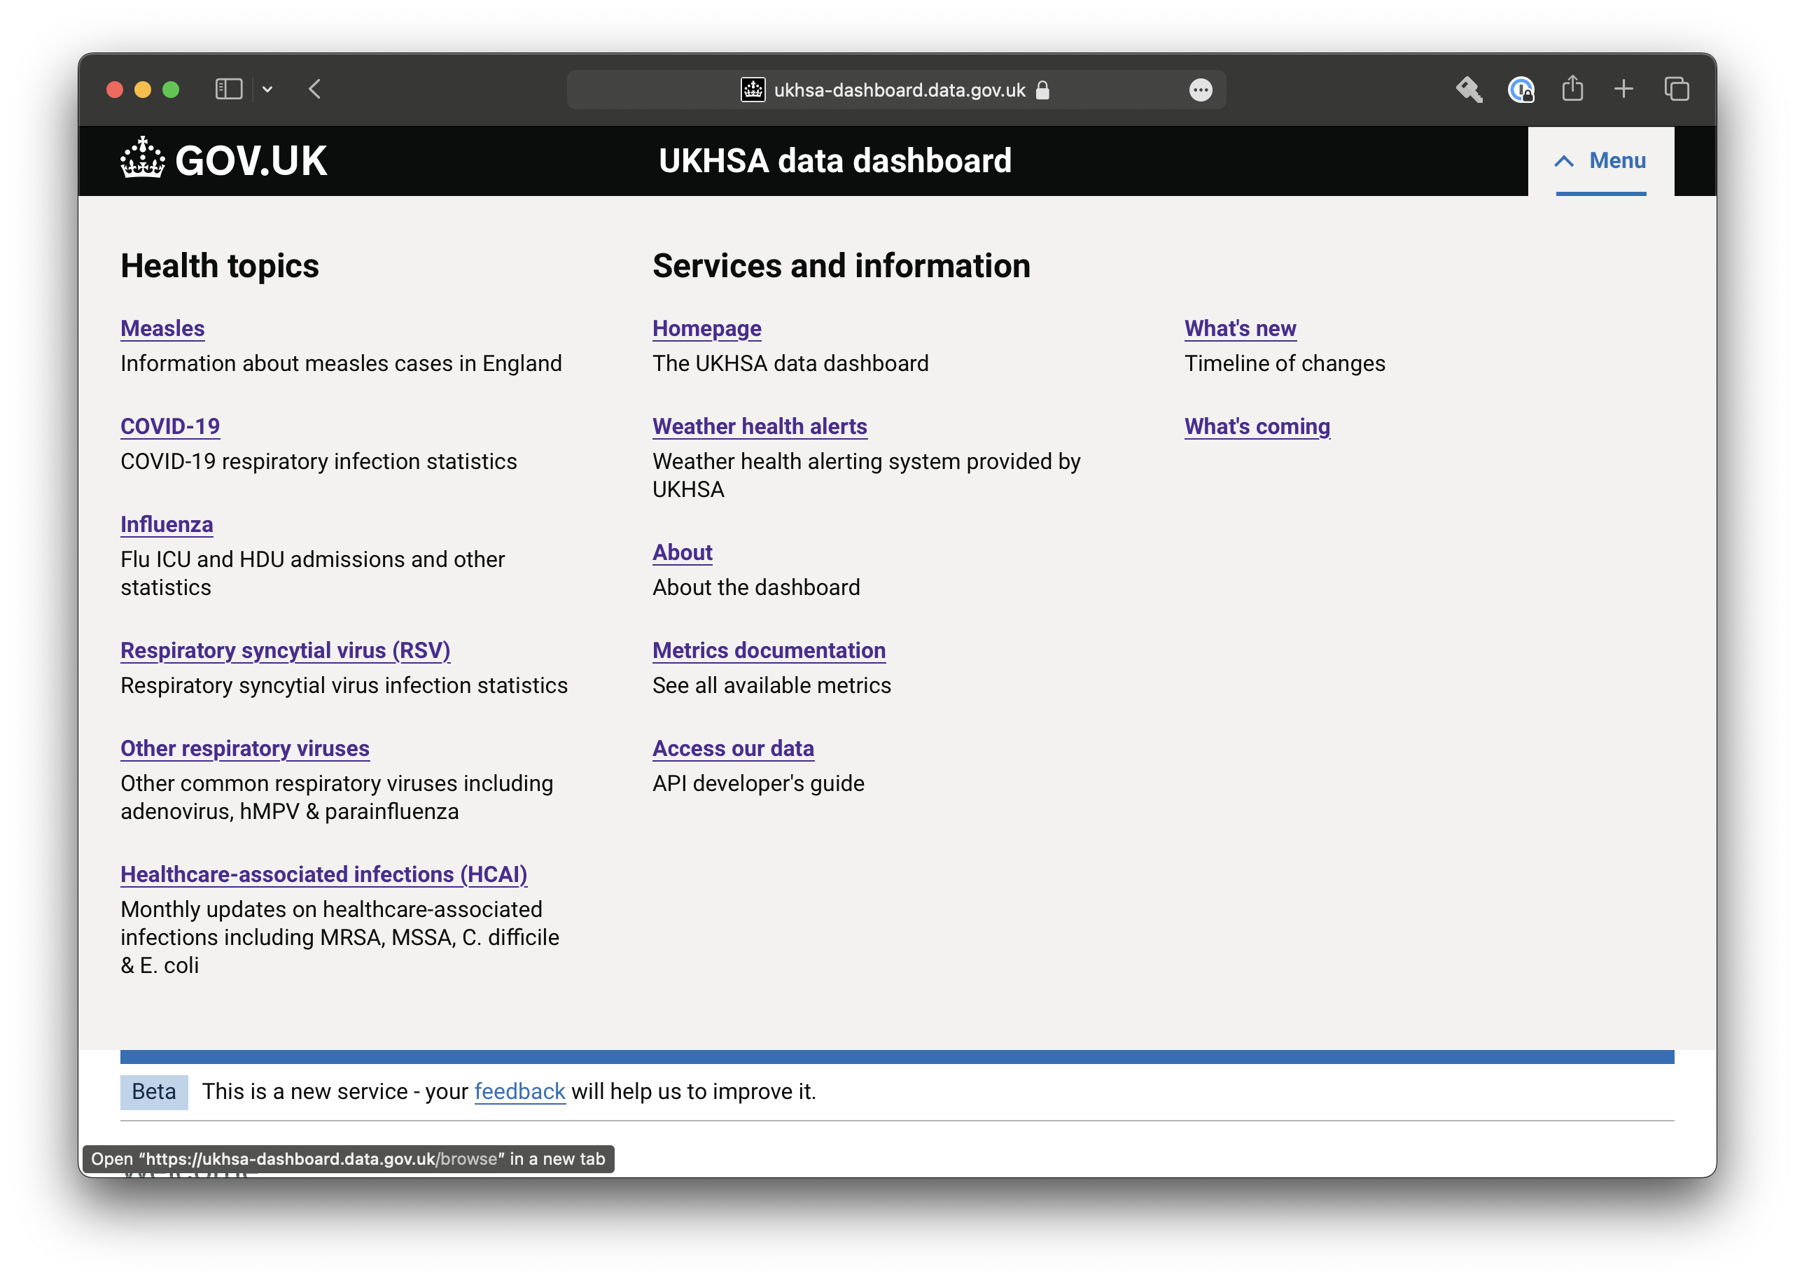
Notes:
My personal story (kev)

Slide 25
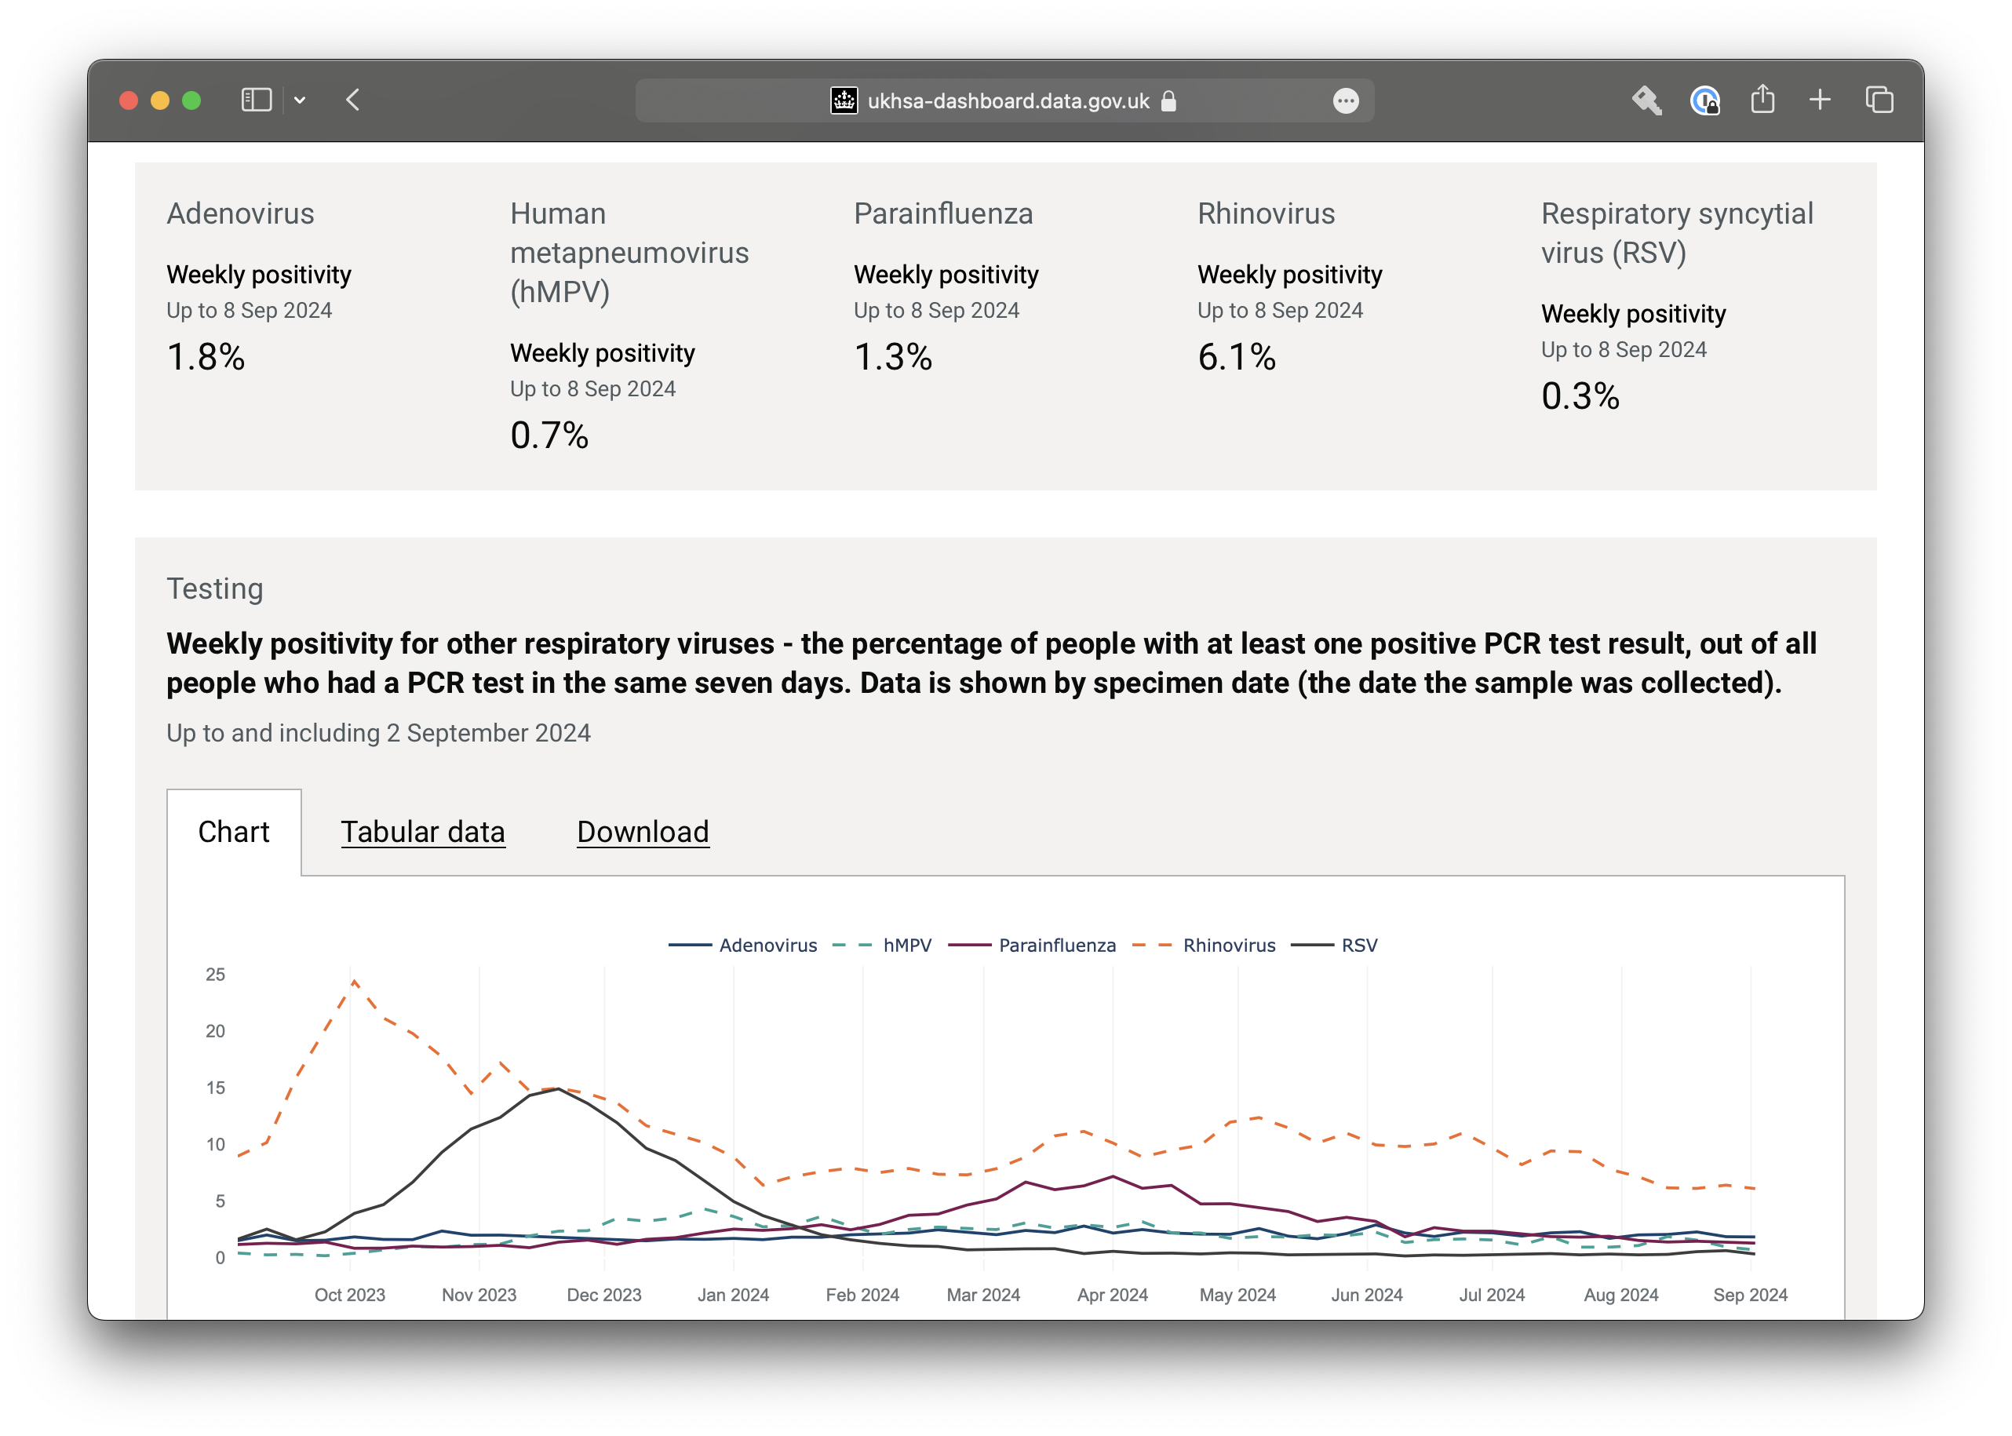
Notes:
No servers
Lots of managed services
Caching
Very little compute – containers and lambda
Graviton
Right sizing
Turn off when not needed
30% cost saving. 30% CO2e saving.
90% cost saving on previous solution

Slide 26
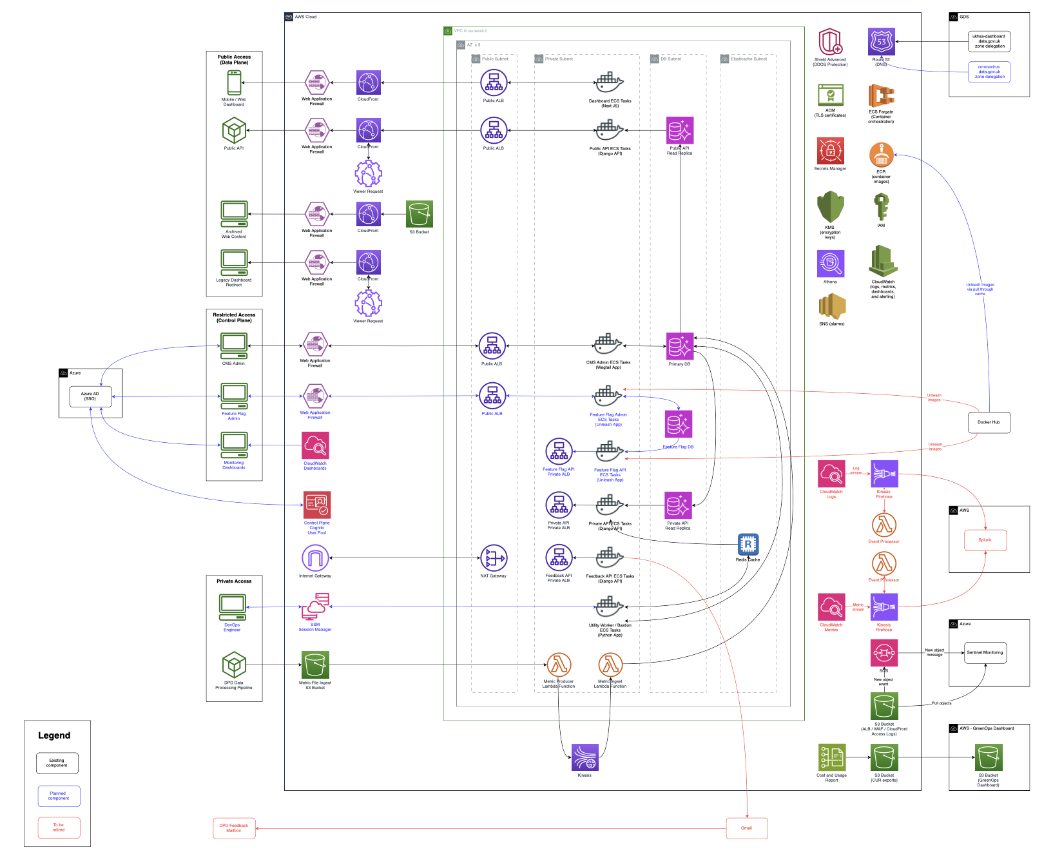
Notes:
No servers
Lots of managed services
Caching
Very little compute – containers and lambda
Graviton
Right sizing
Turn off when not needed
30% cost saving. 30% CO2e saving.
90% cost saving on previous solution

Slide 27
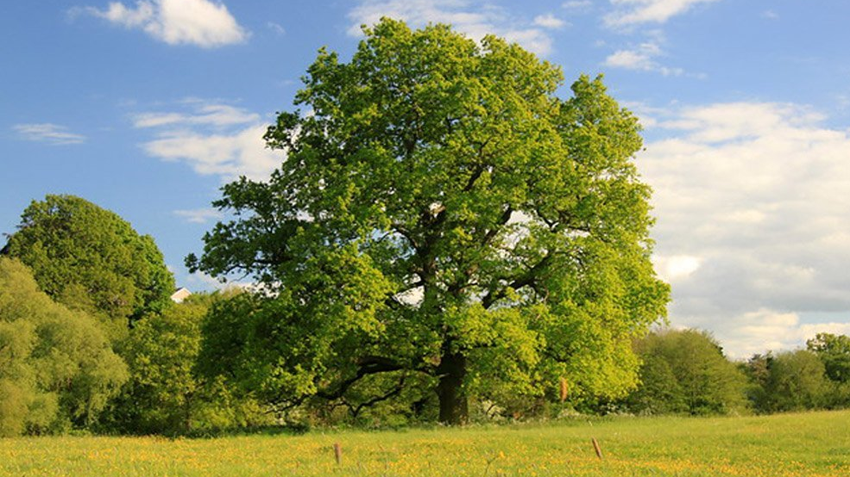
Notes:
Cloud Carbon Footprint
Convert $ spend into CO2e
POC
AWS Customer Carbon Footprint tool
MTCO2e
Roll out across the estate using AWS organizations

Slide 28
Getting organization buy in
Notes:
My personal story (Graham)
Understand the problem
Help others understand the problem
Understand the carrots that matter – is it cost or is it carbon?
Establish where the blockers are
Establish a repeatable process
CI/CD
IAC
Constant monitoring and alerting
Embed in governance – make it visibile
Architectures (HLD, LLD)
Include cost metrics
Upskill the teams – make it achievable
Serverless/PaaS
Build a tech radar to drive the practice
Celebrate your achievements – make it successful
Understand your baselines
Set a target

Slide 29

Notes:
There is no planet b – mike berners-lee
Data centers account for up to 3% of global carbon emissions, while the aviation industry accounts for just 2%
It’s not hard
Every little helps
Focusing on the sustainable choices helps the bottom line and the planet too

Slide 30

Notes:
There is no planet b

Slide 31


Slide 32
Tell me more

Slide 33
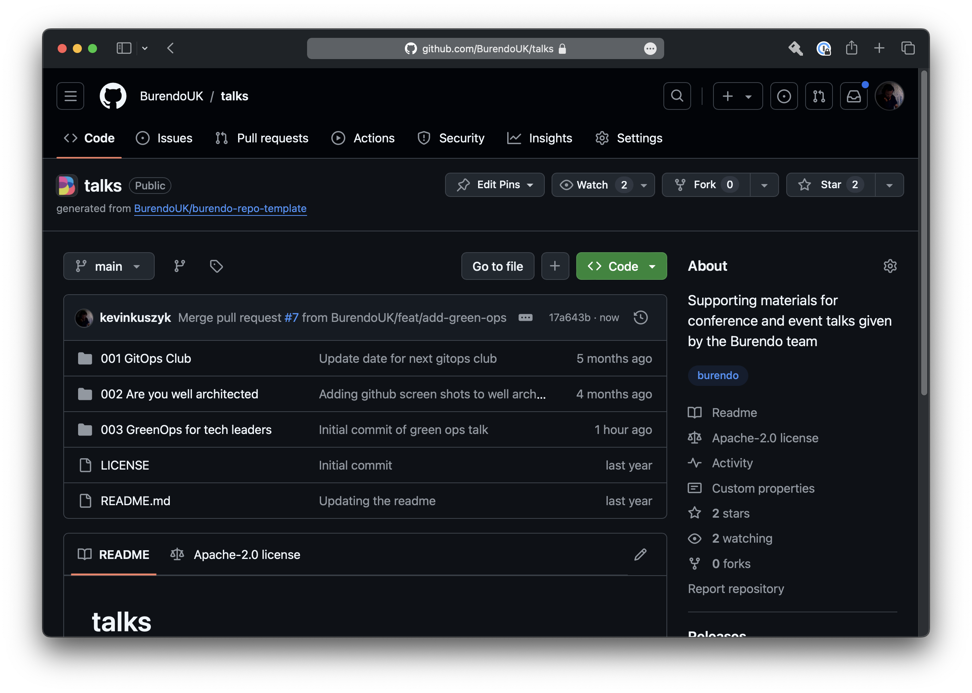

Slide 35
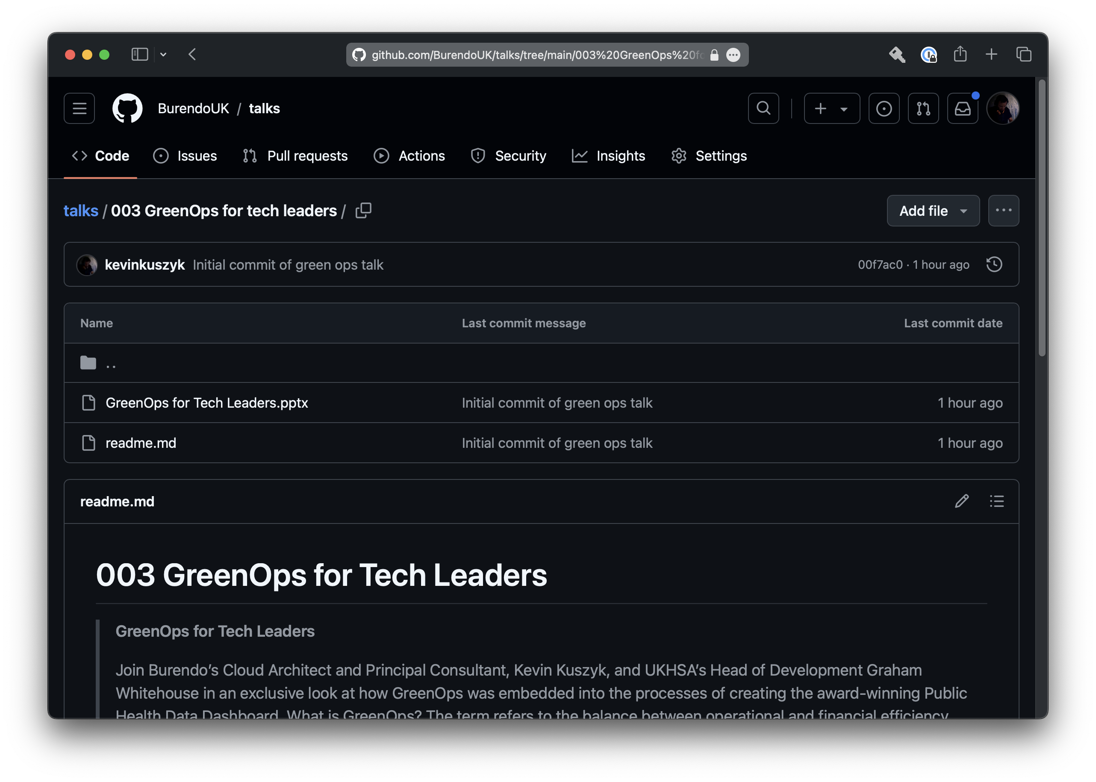

Slide 37
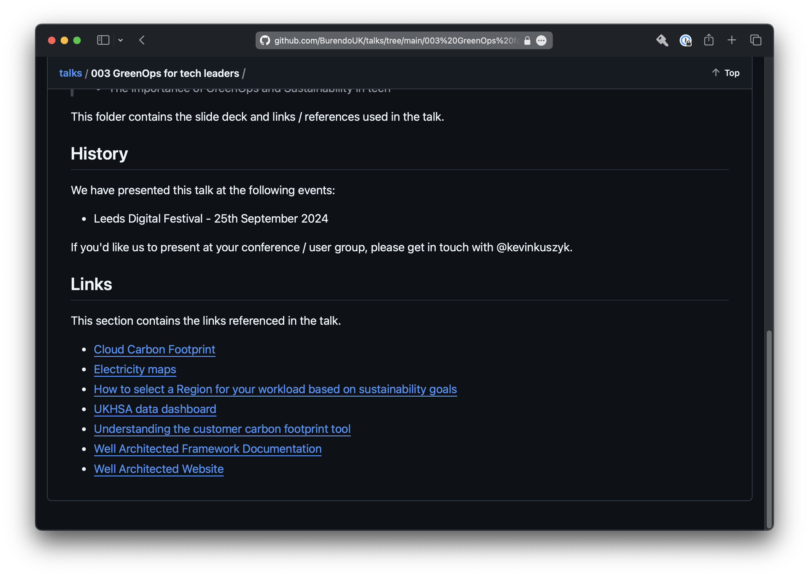

Slide 39

BurendoUK/talks
graham.whitehouse@ukhsa.gov.uk
kevin.kuszyk@burendo.com

Slide 40
Thank you

